Slide 1
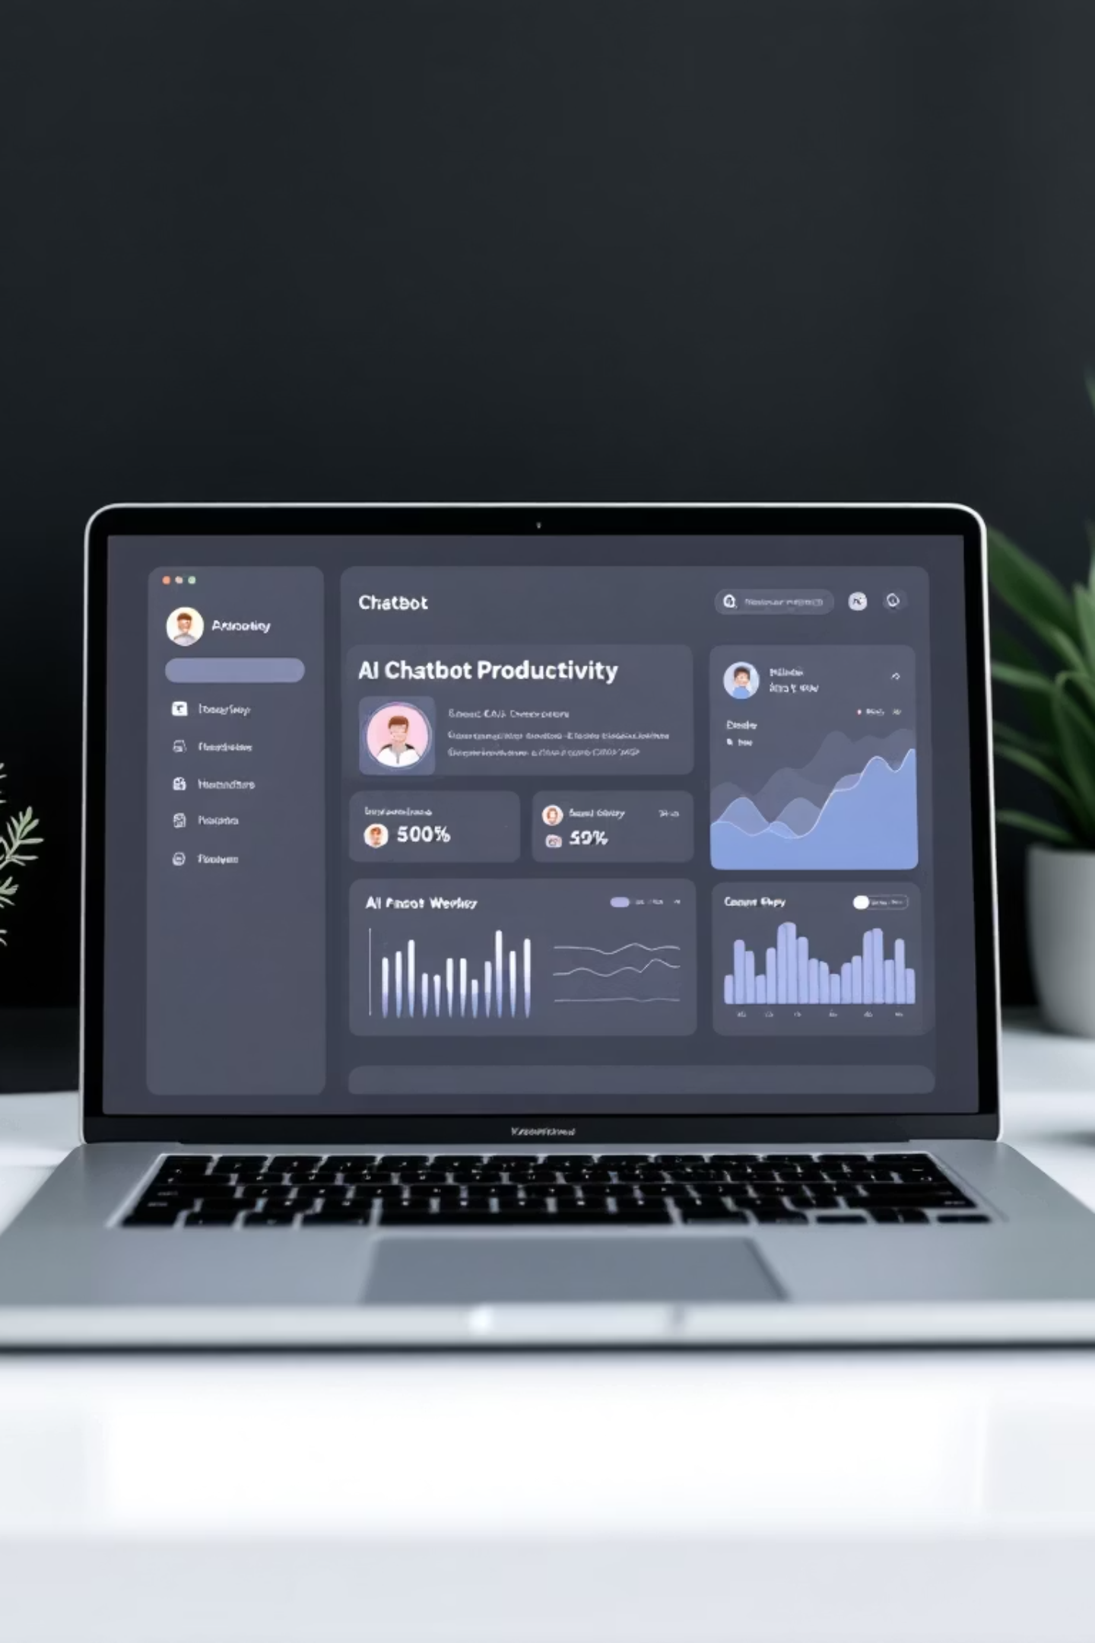
Intelligent Text-Based Chatbot for Personal Productivity
A comprehensive project report on developing an intelligent conversational assistant for managing daily tasks, schedules, and productivity workflows through natural language processing.
A. PAVAN – 323129512060

Slide 2

The Productivity Challenge
Information Overload
Complex Tools
Users struggle to organize information from multiple sources effectively in today's fast-paced digital world.
Traditional productivity tools require multiple applications with complex interfaces and steep learning curves.
Context Switching
Moving between different applications reduces productivity and creates workflow disruptions.

Slide 3





















Project Objectives
01
02
Functional Chatbot
Core Features
Develop a text-based chatbot that accurately responds to user queries through natural language processing.
Implement task management, scheduling, and reminders to help users manage daily activities.
03
04
User Experience
Scalable System
Create an engaging, responsive, and intuitive interface with real-time feedback capabilities.
Build maintainable architecture using modern web technologies for future growth.

Slide 4
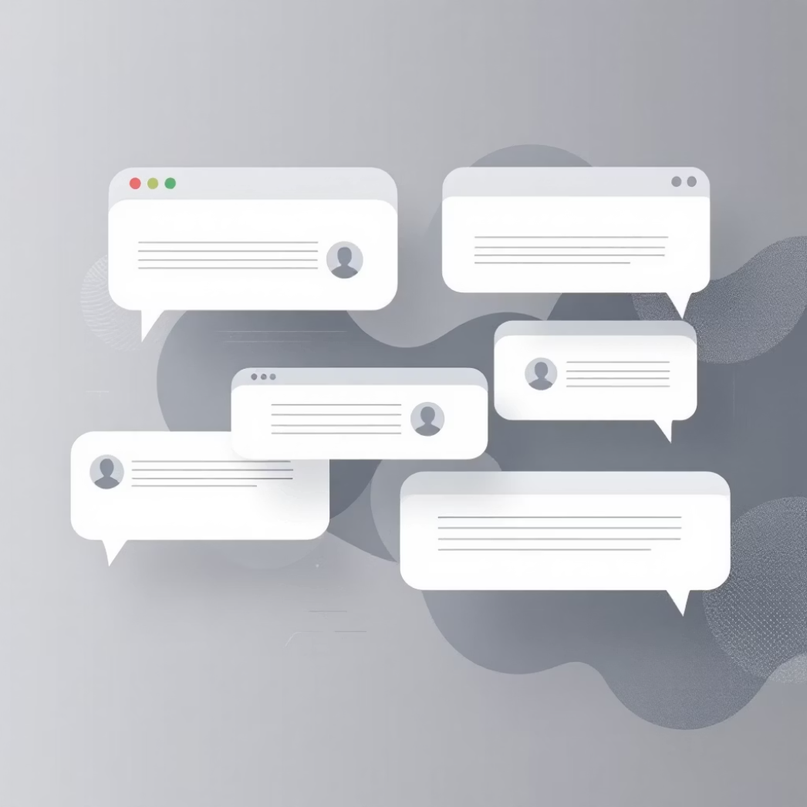
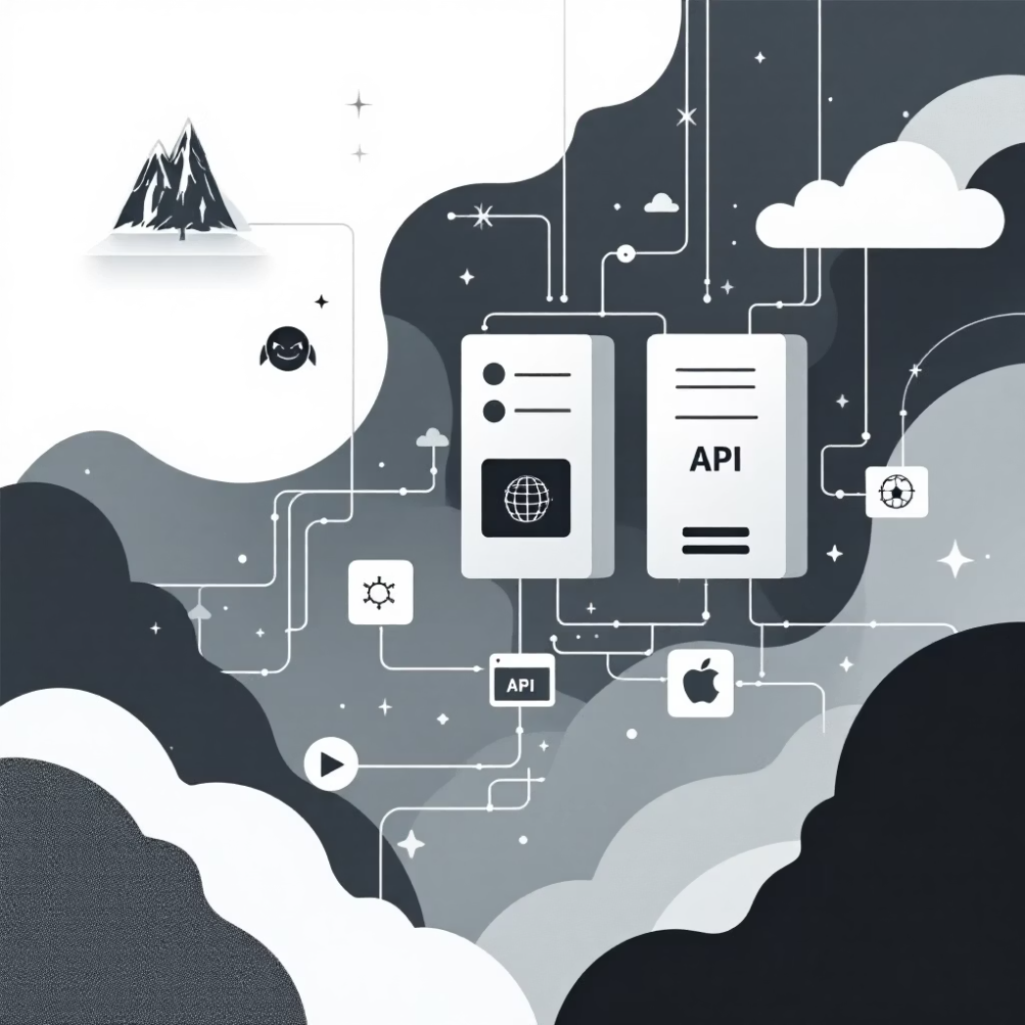
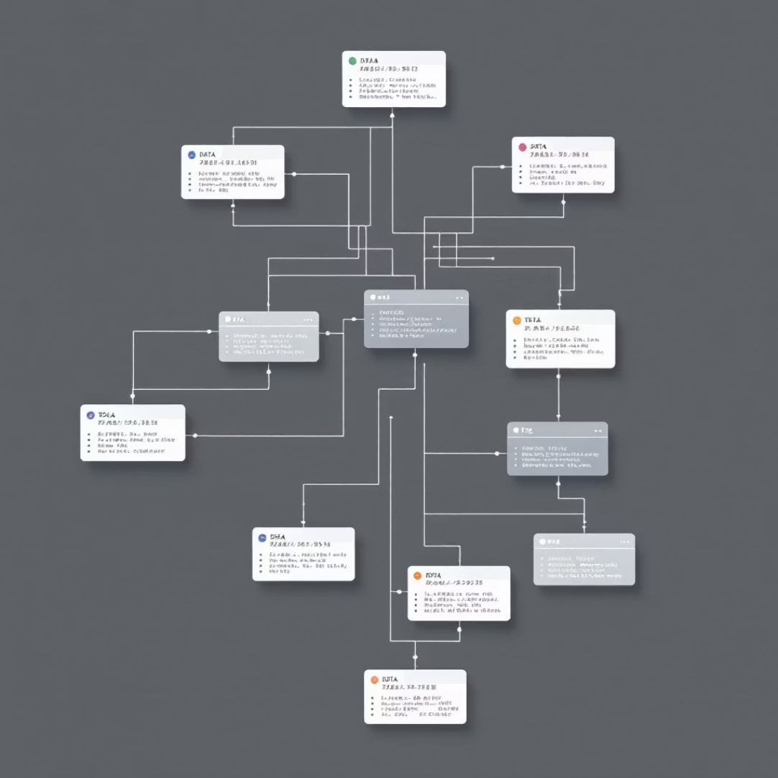
System Architecture
Presentation Layer
Application Layer
Data Layer
Responsive web interface built with HTML, CSS, and JavaScript providing real-time chat experience.
Flask-based application handling business logic, NLP processing, and API endpoints.
SQLite database storing user data, conversations, and relevant information securely.

Slide 5
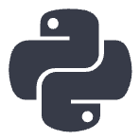


Technology Stack
Backend Technologies
Frontend Technologies
Development Tools
Python 3.11+ with Flask 2.3+ framework, SQLite database, and NLP libraries including NLTK, spaCy, and TextBlob for intelligent processing.
HTML5, CSS3, and JavaScript (ES6+) for creating responsive interfaces, real-time communication, and dynamic user interactions.
Visual Studio Code, Git/GitHub for version control, pytest and Jest for testing, Docker for containerization and deployment.

Slide 6
Implementation Phases
Project Setup & Foundation
1
Environment setup, database design, and project structure establishment with dependency management.
2
Backend Development
Flask application creation, NLP engine implementation, and API endpoint development for core functionality.
Frontend Development
3
User interface design, chat functionality implementation, and responsive design for multiple devices.
4
Integration & Testing
System integration, comprehensive testing strategies, and performance optimization across all components.
Deployment & Documentation
5
Production deployment, user manual creation, and technical documentation for maintenance and future development.

Slide 7
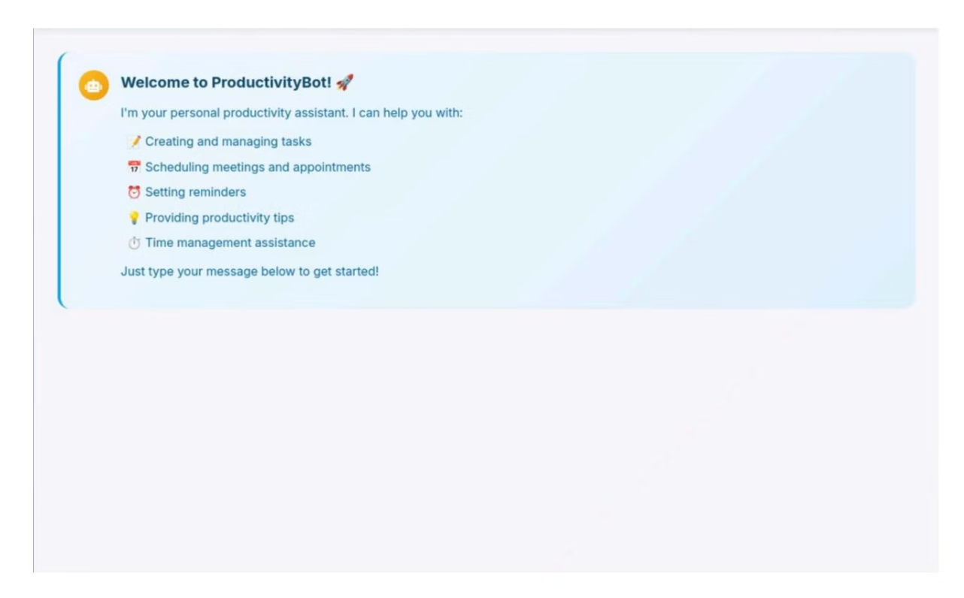
Core Features & Interface
Natural Language Processing
Intent recognition and entity extraction using pattern-matching and NLP techniques for conversational interactions.
Real-Time Communication
WebSocket connections enable bidirectional communication with typing animations and instant responses.
Productivity Management
Task creation, scheduling, reminders, and productivity tips delivered through intuitive chat interface.

Slide 8
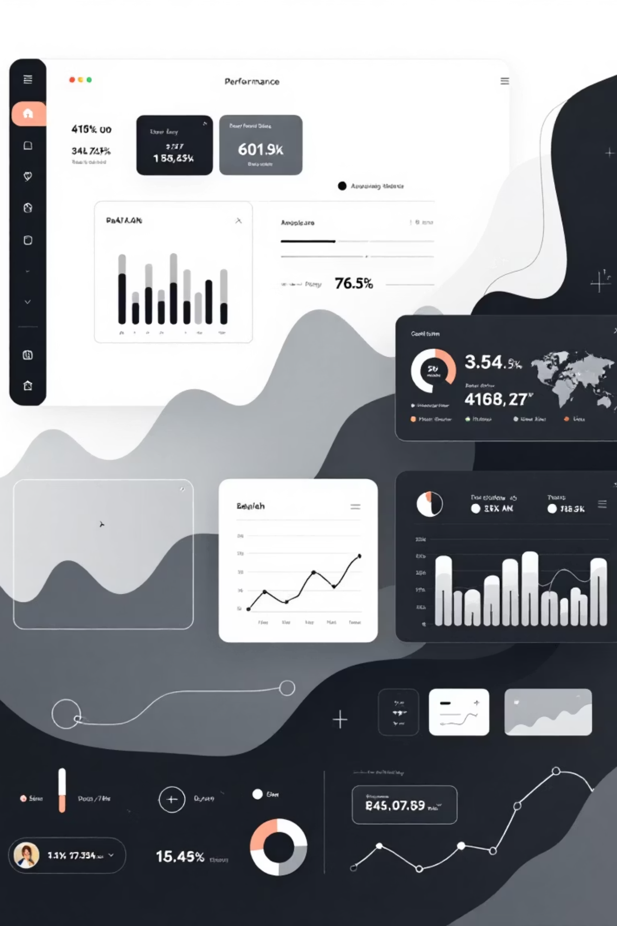
Testing Results & Performance
55.6%
100%
0.006s
NLP Accuracy
API Success
Processing Time
Intent recognition success rate with room for improvement through further training.
All API endpoints performed as expected with complete functionality.
Average NLP processing time well within target performance metrics.
0.014s
Response Time
Average API response time exceeding performance expectations.

Slide 9
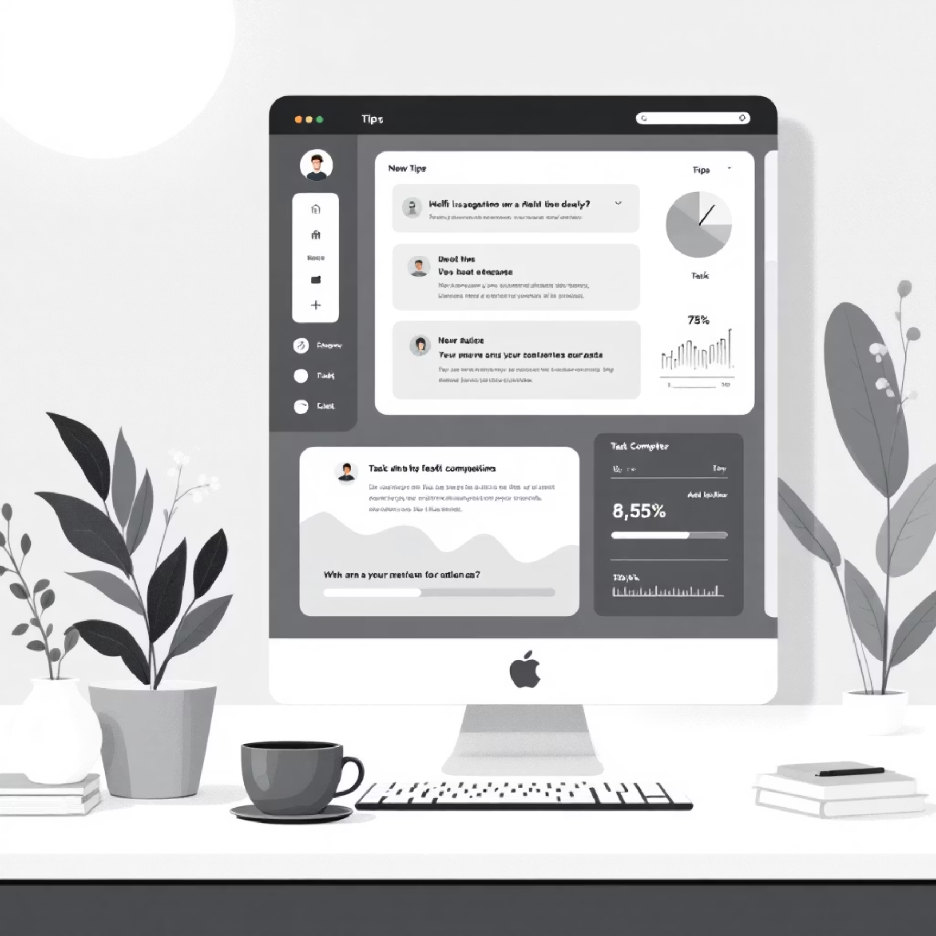
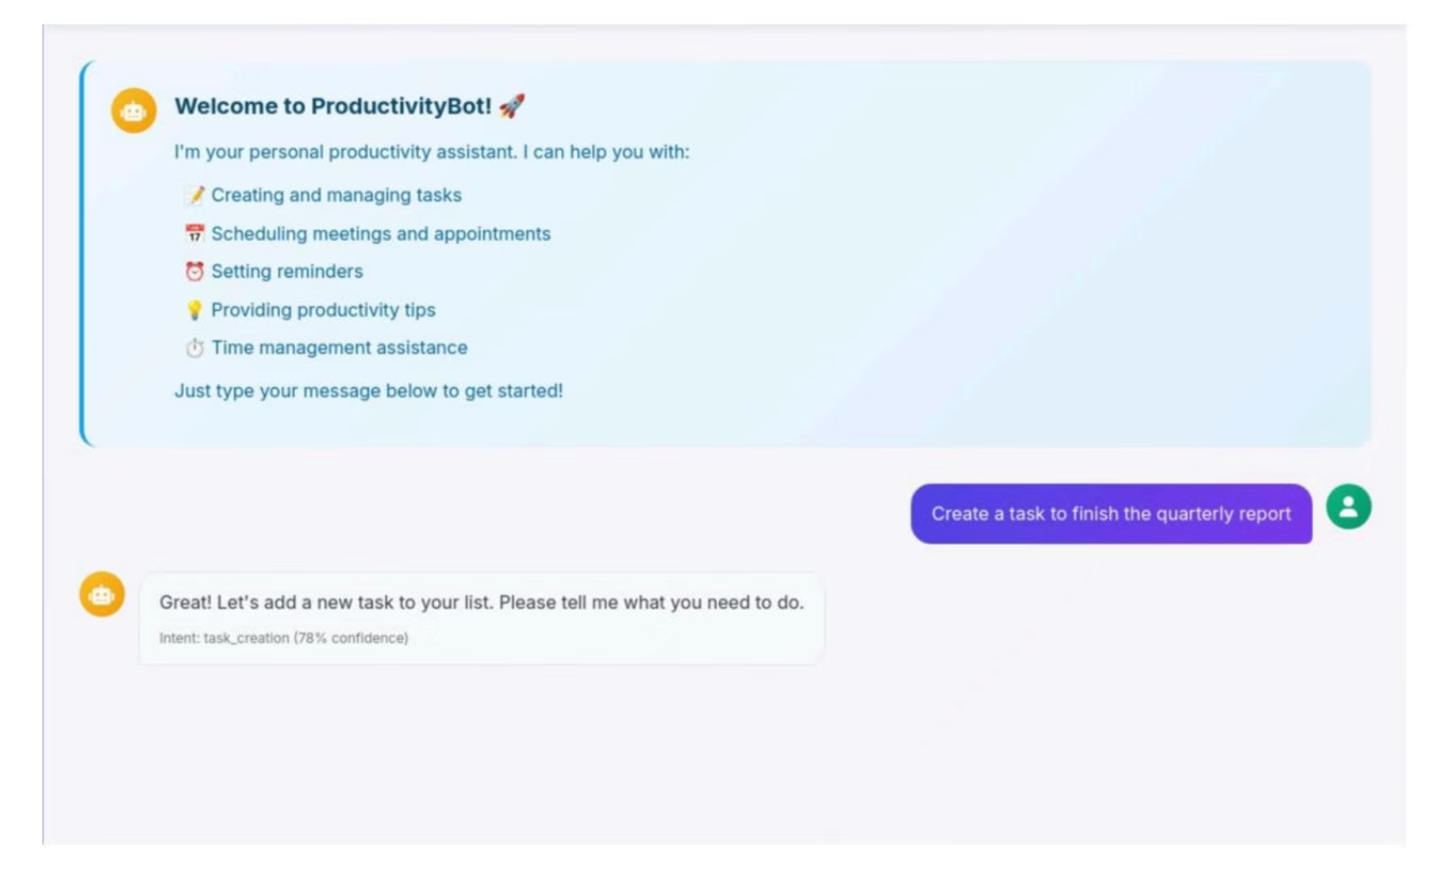
Task Management in Action
Productivity Insights
Task Creation Feature
The chatbot provides personalized productivity tips and suggestions based on user behavior and task patterns.
Users can create tasks through natural language commands, with the system extracting relevant details and scheduling information automatically.

Slide 10





Future Enhancements
Enhanced NLP
Improve intent recognition accuracy through advanced training and machine learning models.
Extended Integration
Add calendar, email integration, and support for complex multi-step queries and workflows.
Personalization
Implement user profiling and personalized responses based on individual behavior patterns.
Global Reach
Add multi-language support to serve diverse global audiences and expand accessibility.

